Slide 1
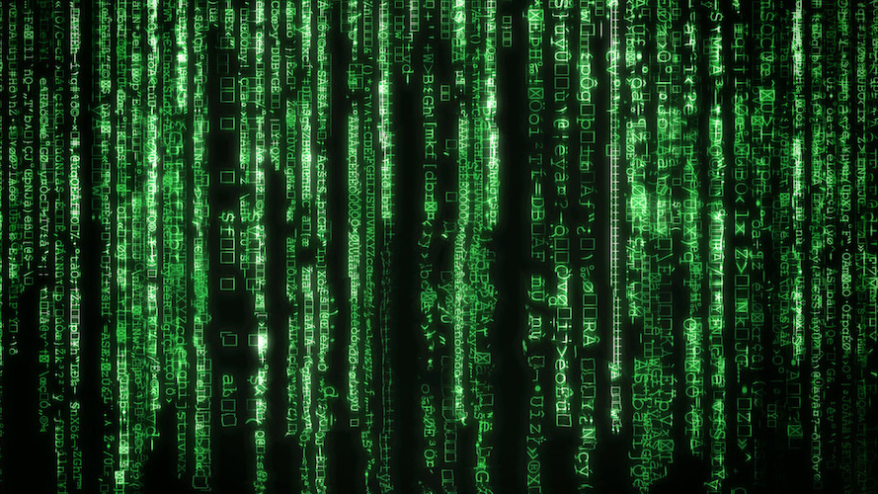

Generations Of Computer
By Varshith
This Photo by Unknown Author is licensed under CC BY-NC-ND

Slide 2
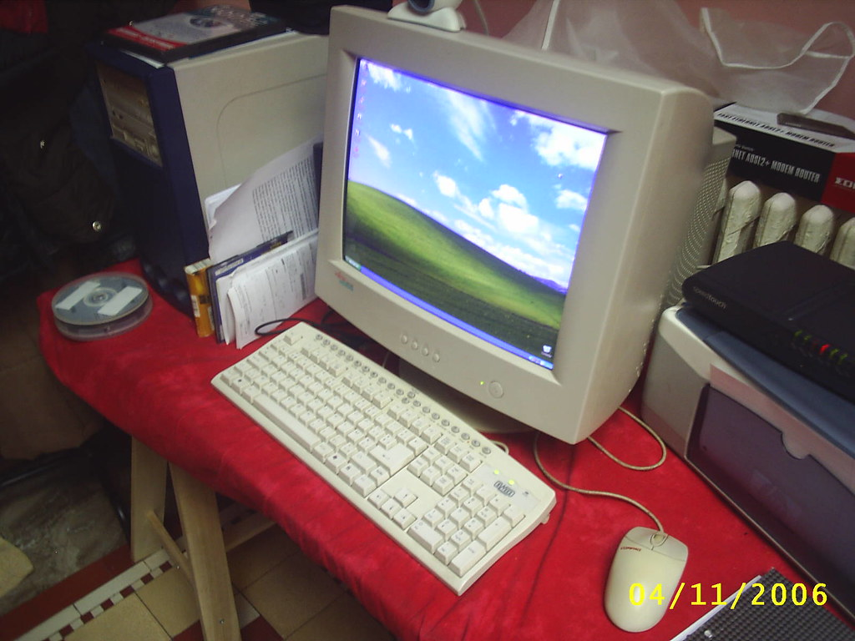
What is a computer?
A computer is like a personal assistant. It helps you talk with other people through webcam do stuff etc. It is very fast and smart. In other words, it is a device, usually electronic, that processes data according to a set of instructions. The digital computer stores data in discrete units and performs arithmetical and logical operations at very high speed. It stores data in the form of binary (0’s and 1’s). There are generations of computers. There are five generations of computers. Let us learn about them.
This Photo by Unknown Author is licensed under CC BY

Slide 3
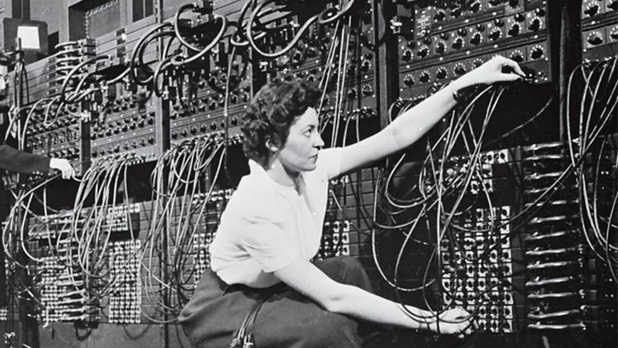
First Generation language (or) Machine Language
Machine language is expressed in the form of binary, i.e., 0s and 1s where 0 is off and 1 is on. It has and advantage of high speed and low memory utilisation. It is very hard to understand and learn machine language thus being very time consuming. Machine language is extremely machine dependent, that’s why it is called low level language(LLL).
This Photo by Unknown Author is licensed under CC BY-SA

Slide 4
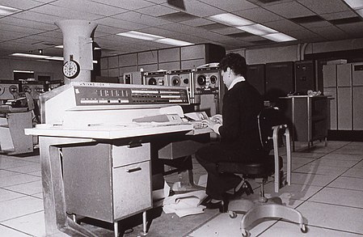
Second generation language (or) assembly language
This language uses mnemonic codes or symbols in the place of binary. For example of the operation code for ADD is 100000110001001000100
It can simply be written as ADD in this language. So this language is easier to work with. But this language is also machine dependent so this is also a low level language.
This Photo by Unknown Author is licensed under CC BY-SA

Slide 5
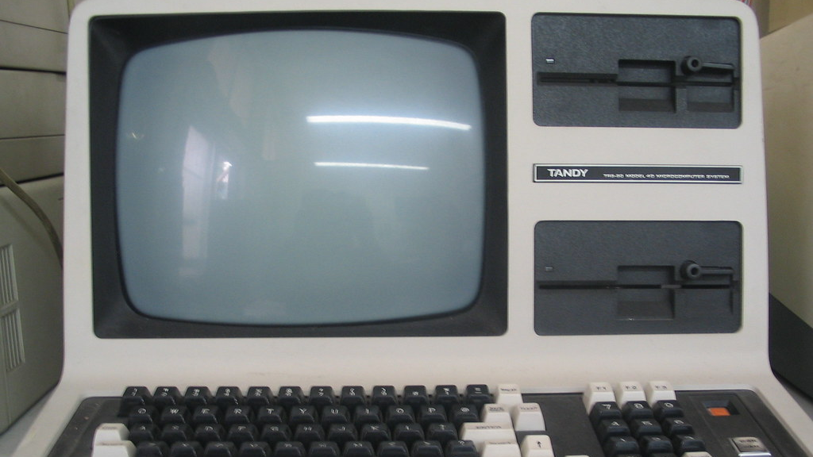
Third generation language (or) high level language.
This language is much more easier than the previous two languages. It is simple and user friendly and machine independent language. This language became very popular as many people started uding this language thus being regarded as high level language (HLL). This language is quite similar to English.
This Photo by Unknown Author is licensed under CC BY-SA

Slide 6
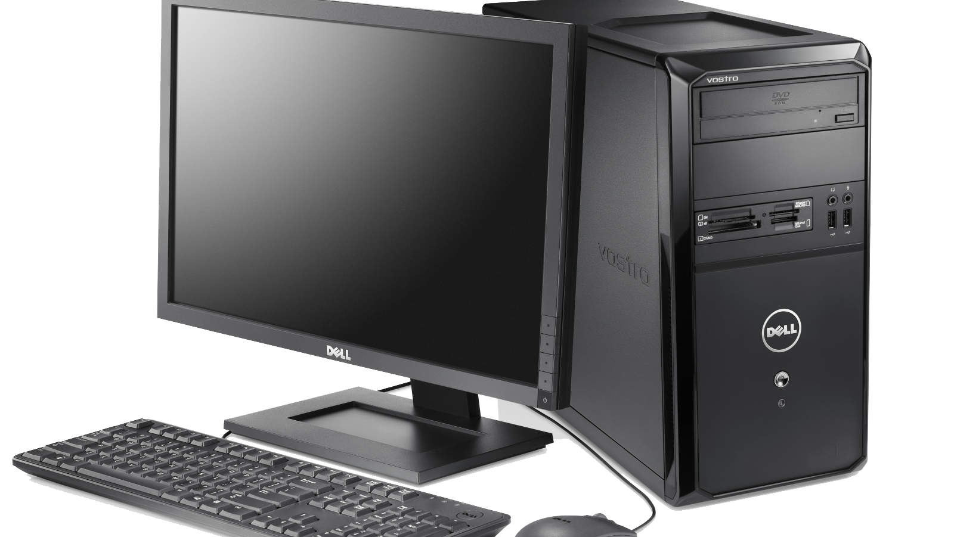
Fourth generation language (or) Very high level language.
This language is also very easy to use. It is highly user friendly and independent of any operating system. This language is more advanced than the other two. Very high speed of execution, designed to reduce the level of programming efforts. It is designed to reduce time.
This Photo by Unknown Author is licensed under CC BY-NC

Slide 7
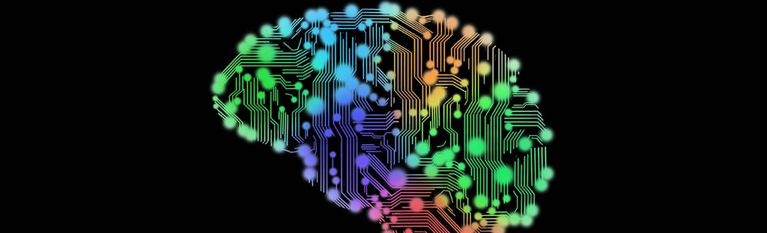
Fifth generation language (or) AI
There is not much about it. It tis the upcoming language of the future. This language may be extremely fast and very highly user friendly.
This Photo by Unknown Author is licensed under CC BY

Slide 8

Translator programs
The computer can only understand machine language. So it must be converted from high level language to low level language. The translator programs do the same. There are there types of translator programs:-
Assembler
Interpreter
Compiler

Slide 9
Assembler and Interpreter.
Assembler- An assembler is a program that is used to convert mnemonic codes into their machine language equivalents.
Interpreter- An interpreter translates a program written in high level language into a low level language line by line. It is usually preferred by beginners as it is slow.

Slide 10

Compiler
A compiler converts the whole program at one and also shows the list of errors and bugs. Its speed is greater than the one of interpreter.

Slide 11

Thank you

